Slide 1
Introduction to R and RStudio
DS 100 — Module 2

Slide 2
Module 2 Learning Objectives
By the end of this module, you will be able to:
  Navigate the RStudio interface and explain the purpose of each pane
  Apply project and file organization principles for a reproducible analysis
  Import and inspect a dataset using the tidyverse
  Recognize and correct common data type misassignments
  Apply a systematic data validation checklist after importing data

Slide 3




R
Programming language for
data analysis
RStudio
Interactive development environment (IDE)
R Markdown
Computational document format
Quarto
Computational document format
Notes:
I’m sure you all are excited to get started programming and we will do that in just a few minutes.
Before we do that I want to introduce you to 3 items.
The first is R. R is a programming language for data analysis. There are lots of great things about R: it is freely available, great for wrangling data, and very capable for producing impressive visualizations. There is also a great community of folks using it for data science, and we are excited to welcome you all to the R community via this course.
(**) Then, there’s RStudio. RStudio is the name of a free piece of software made by the company Posit (formerly known as RStudio). You can think of RStudio as a sophisticated text editor for writing R code. You can run RStudio on Mac or Windows, or on a server.
(**) Finally there’s R Markdown. (**) Or at least that what we used to say when we taught this course. The next generation of R Markdown known as (**) Quarto was recently released. Quarto is a computational document format that has executable code. Quarto also includes capabilities for annotating your work which is incredibly handy and supports multiple programming languages for mixing and matching code.
R, RStudio, and Quarto synergize for a robust ecosystem for performing data analysis.

Slide 4
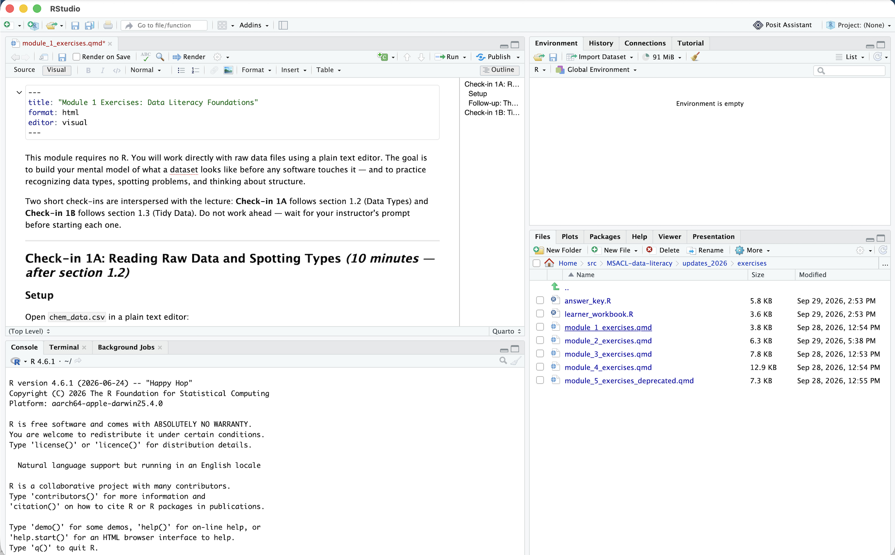
ENVIRONMENT
SOURCE
CONSOLE
FILES

Slide 5
Reproducible Data Analysis with Quarto
Notes:
One of the most powerful aspects of working in the R environment is the ability to conduct reproducible data analyses (those analyses that can be shared, revised, repurposed and reproduced) by others.

Slide 6
Notes:
Quarto provides us with features and tools to tackle the reproducibility problem.
In Quarto, we can craft computer code mixed in with narrative annotation that documents the purpose of the code and details about the decisions we made in our analysis.
Quarto provides a lab notebook interface for analysis, visualization, and annotation of our work.
Like R Markdown before it, Quarto is quickly becoming the gold standard for reproducible data analysis. In the course we will teach you to use Quarto and we encourage you to continue using it consistently in your future work. In fact, it is the strongest recommendation we will make to you today.

Slide 7
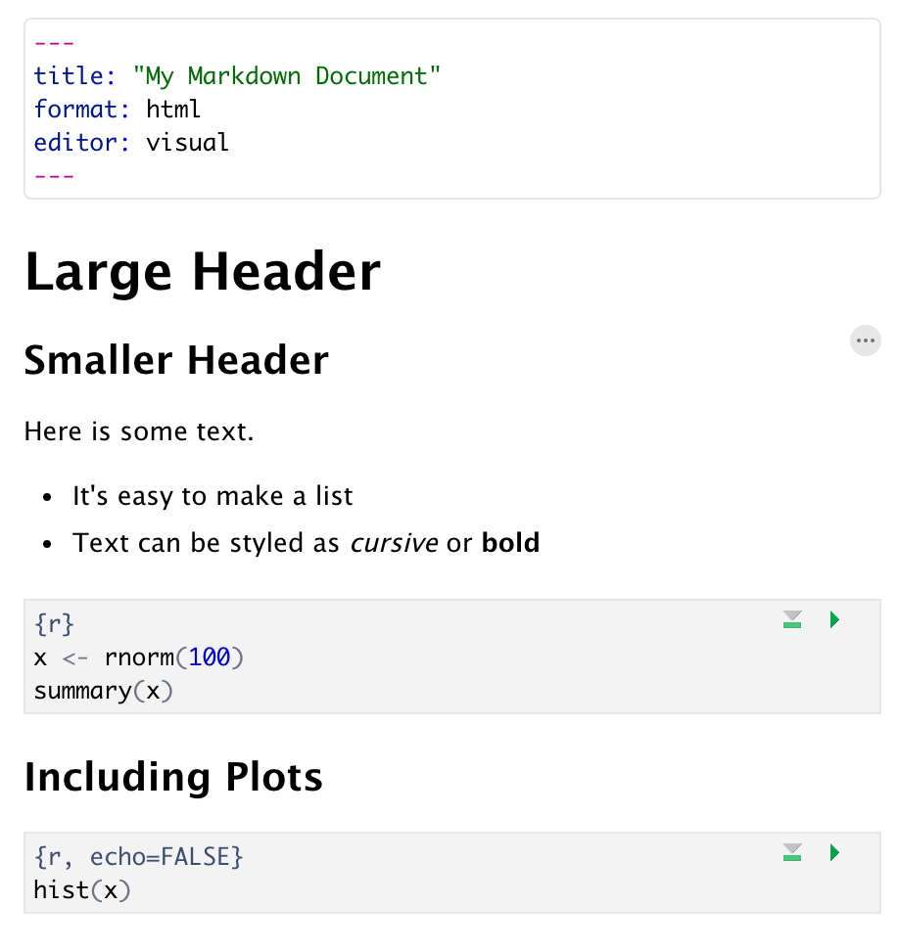
Anatomy of a Quarto Document
Header
Header
Text
(w/ formatting)
Code chunk
Notes:
Quarto documents are composed of 3 basic building blocks.
**The first is the Header which includes pieces like the name of the document, the document’s author, and the desired output format when the document is assembled.
**The second block is the text. Quarto documents can be marked in ways that promote readability with various formatting styles.
**Finally, there are code chunks. Code chunks include include R code that can be executed to output results.

Slide 8

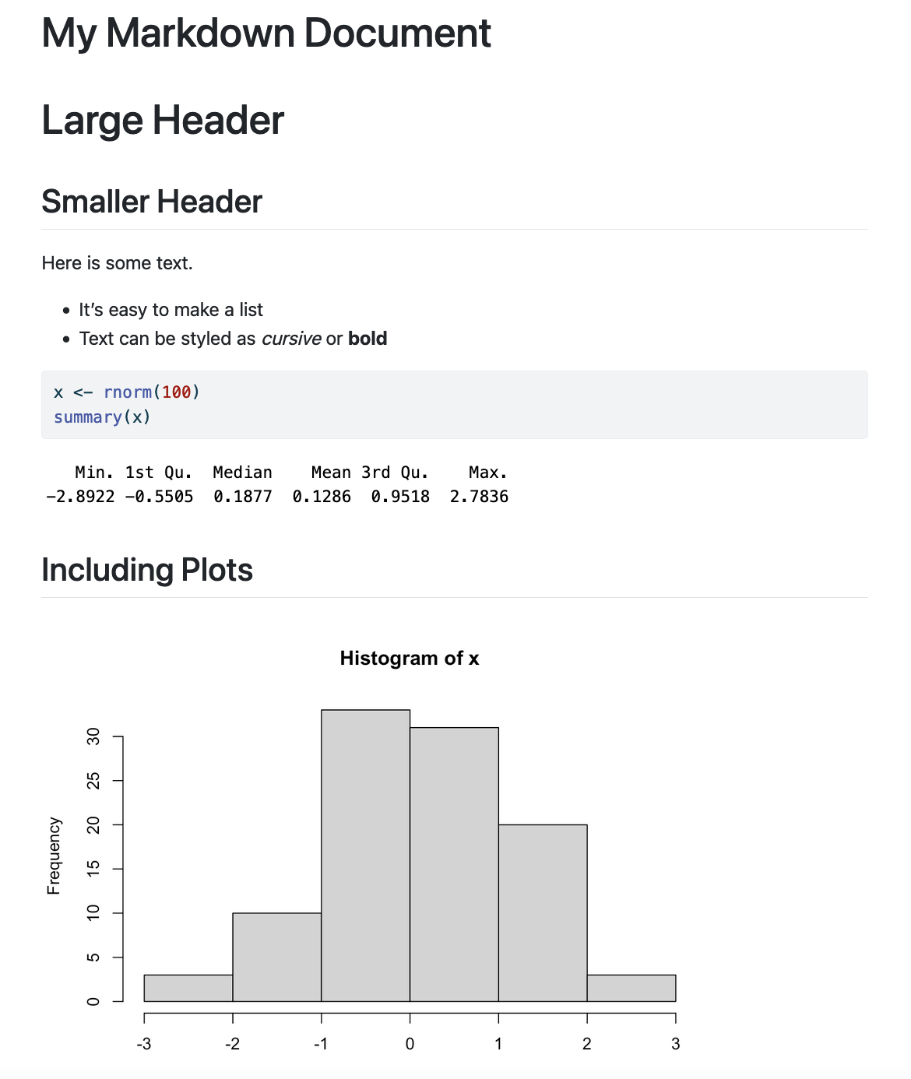
Notes:
Within the Quarto document, we can execute a single code chunk by ** clicking the “Run Code Chunk” arrow.
And with the click of a button ** (called rendering), we can turn a Quarto document from this (**) to this.

Slide 9
Notes:
Let’s look at this Quarto document in greater detail.
Again the first block is header section
** The second block includes narrative text with styling applied.
** Then we get to the code chunks (shown in gray boxes). Don’t worry about the grammar of these particular code chunks at this point. In brief the first code chunk generates 100 normally distributed values which are performing a summary on. The rendered document shows us our code ** and the output of that code.
** The second code chunk renders a histogram visualization of that data.
The result is a neatly formatted document that includes an annotated description of our analysis, the code we used, and the output of that code.

Slide 10
Your Turn
Open a sample Quarto document (File -> New File -> Quarto Document). Enter My First Quarto as the title in the prompt and press Create.
Review the format of the document: header, text, code chunks
Execute the individual code chunks by selecting the Run Current Chunk arrow.
Render the document to HTML. You will prompted to save your Quarto Document first. Name it Module 2 – Quarto Intro and click save. Review the rendered document.
Notes:
It’s your turn again.
Follow the instructions in Your Turn #2 to
-open a Quarto document
-review the format
-execute individual code chunks
-render the document
We will meet back in 3 minutes to review this exercise together.

Slide 11
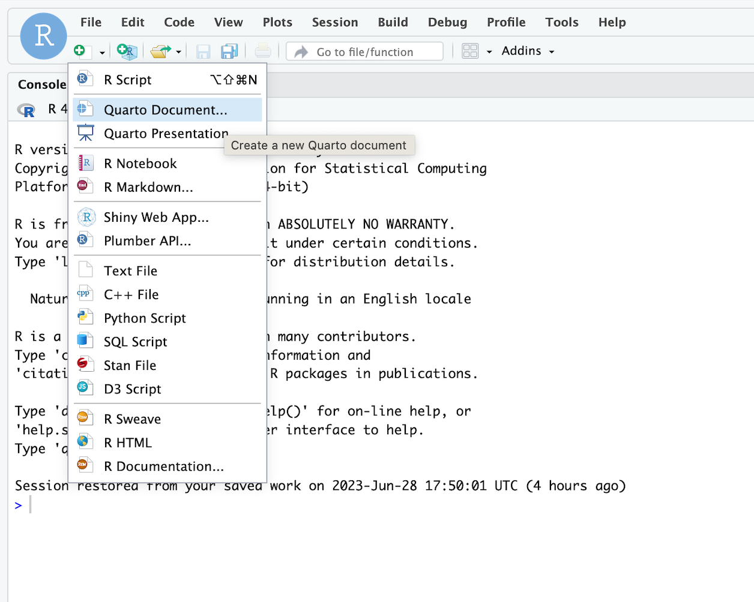

Slide 12
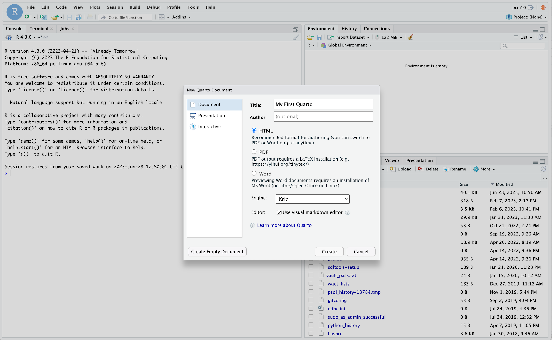
Enter title
Create document

Slide 13
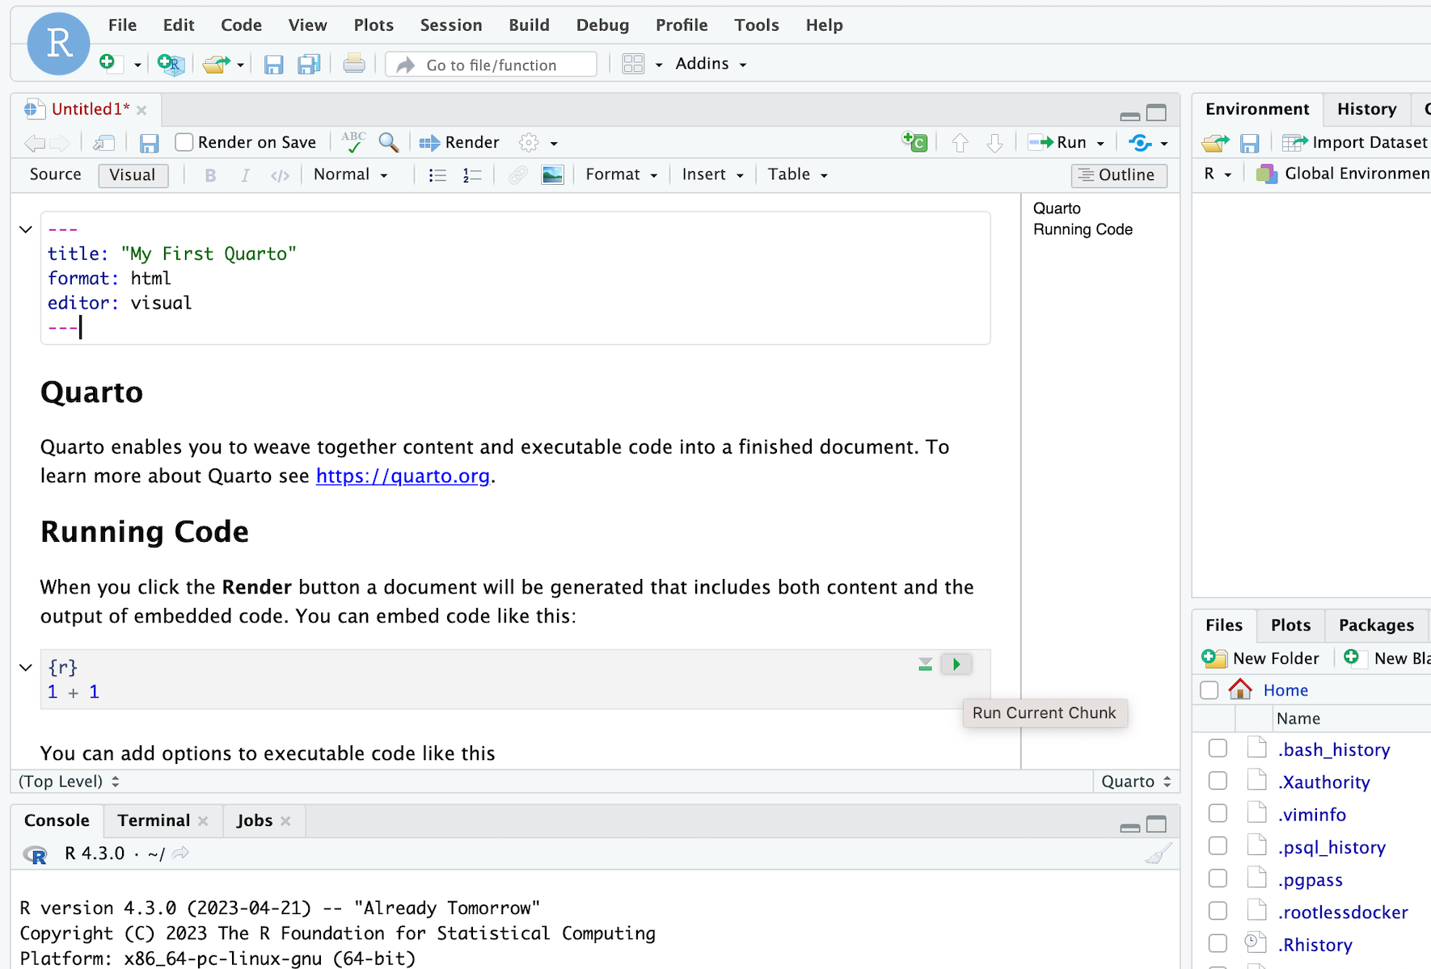
Scroll down
Hit button to run

Slide 14
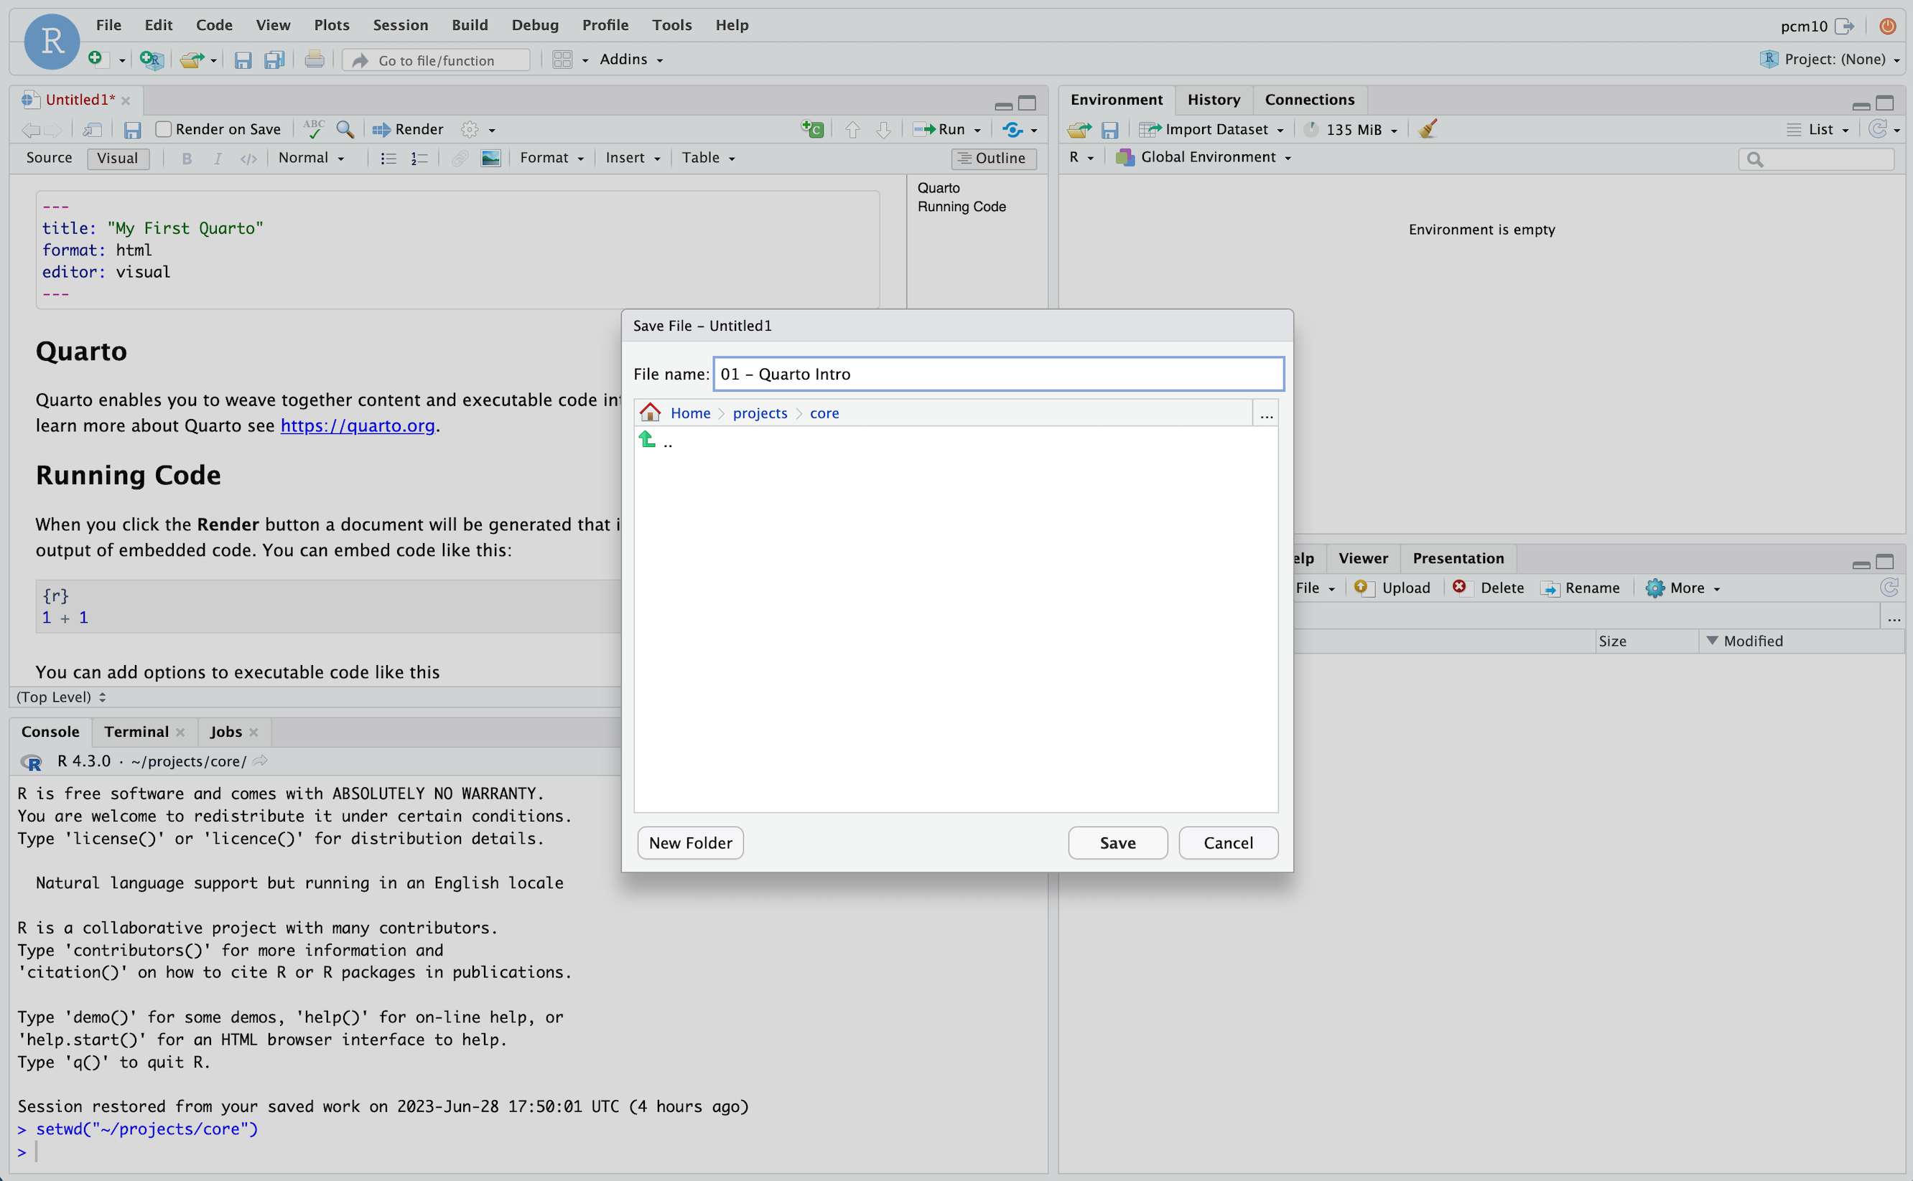
Render document
Name file
Confirm destination
Save file

Slide 15
Your Turn
Open a sample Quarto document (File -> New File -> Quarto Document). Enter My First Quarto as the title in the prompt and press Create.
Review the format of the document: header, text, code chunks
Execute the individual code chunks by selecting the green “play” arrow.
Render the document to HTML. You will prompted to save your Quarto Document first. Name it Module 2 – Quarto Intro and click save. Review the rendered document.
Notes:
It’s your turn again.
Follow the instructions in Your Turn #2 to
-open a Quarto document
-review the format
-execute individual code chunks
-render the document
We will meet back in 3 minutes to review this exercise together.

Slide 16
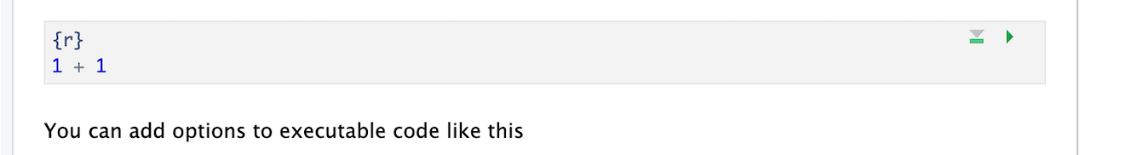
Code chunks
Language
Run chunk
Code in body of chunk
Notes:
So where does the code go?
We place these in “chunks” that are executable independently and have a very unique syntax
Backticks (top left of your keyboard) open and close code chunks

Slide 17
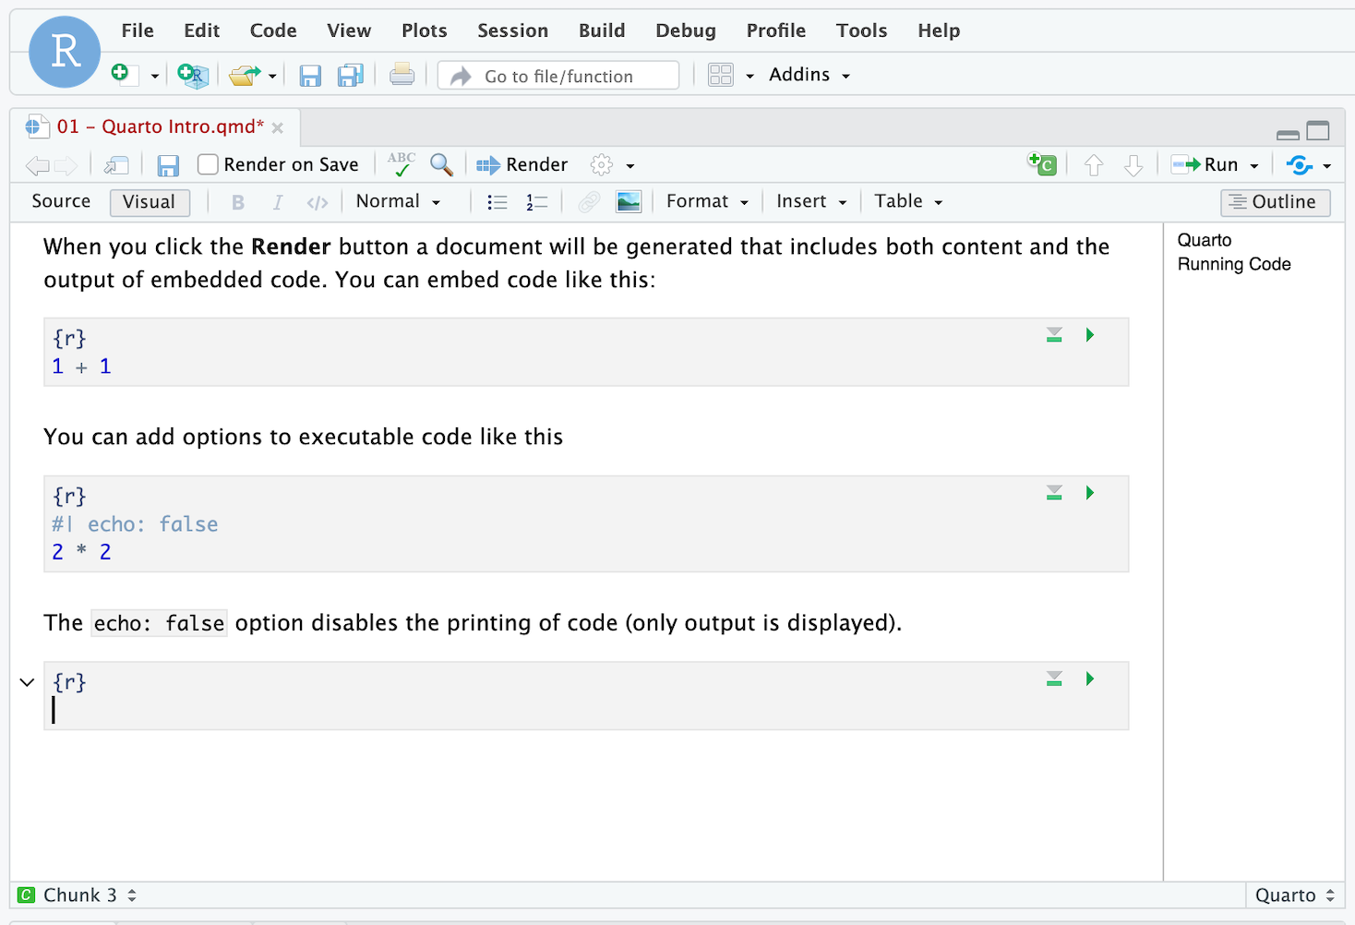
Insert code chunk
Place cursor in document

Slide 18
Your Turn
1. At the bottom of your document insert a code chunk into white space using the +C button on top right of the Editor window
2. Type the following into your new code chunk:
  mean(c(10, 20, 30))
3. Execute code chunk by pressing the run button on top right of code chunk
4. Put up your sticky note when complete
Notes:
Annoying to type 3 backticks every time you want to insert a chunk so let’s walk through doing this with the Rstudio editor

Slide 19
The Basics of Coding

Slide 20
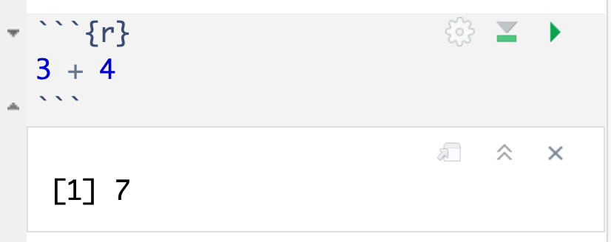
The Basics of Coding: Calculation
press play button to execute code
R is a calculator!
answer returned below
Notes:
At it’s most basic, R is a fancy calculator.
It supports common mathematical operators
+ add, - subtract
* multiply, / divide
^ exponents
When we execute our code by pressing the play button, the answer is returned below the code chunk.

Slide 21
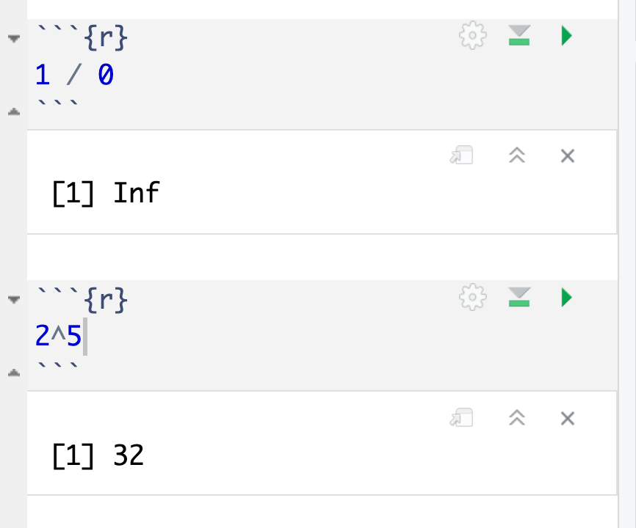
Common arithmetic operations

Slide 22
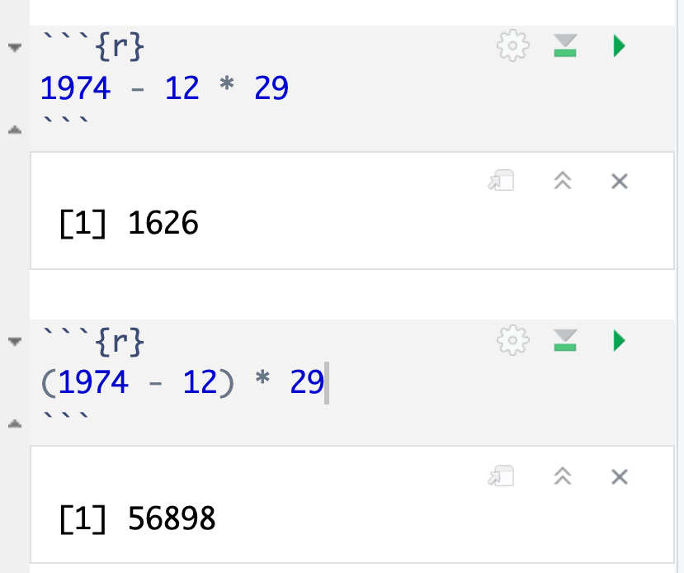
Don’t forget those math rules

Slide 23
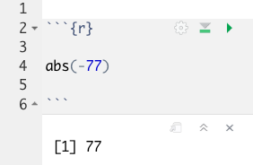
The Basics of Coding: Functions
Code that extends our reach beyond the basic operators
function
(does stuff)
argument
(input)
abs(-77 )
Notes:
Functions are code that perform actions on our behalf. We can use functions that others have written (or that we write ourselves) to reuse existing code over and over.
Functions accept an argument (input). We use parentheses as the syntax (grammar) to identify the argument(s).
Then the function does its task and provides us with some output, in this case the absolute value of an integer.

Slide 24
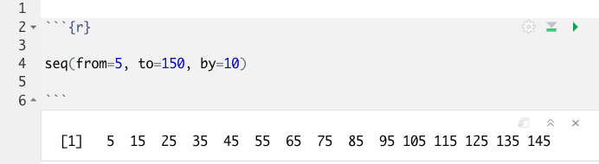
Putting Functions to Work
We can use functions to do more than simple math, we can make things!
We can create a series of integers (a vector) using the seq() function
Notes:
Functions can do more than simple math.
In this case the sequence function seq() accepts arguments defining a start position, a stop position, and an interval, to create a series (a vector) of integers.

Slide 25
The Basics of Coding: Objects
Objects are the container for your output
object
(stores output)
function
(does stuff)
arguments
(input)
sequence_of_10s <- seq(from=5, to=150, by=10 )
Notes:
Objects are a very important concept in many programming language.
Objects are the containers in which we can store things for later use.
You can store single values, series, tables, or even text.
In this example we are taking our previous seq() created series and storing it out to an object which we have called sequence_of_10s.
The <- characters are called an assignment operator. They point to the place where we want to store output.
You can execute code without assigning it to an object however the output is not stored for future use. If you want to revisit or reference the output of a particular line of code, assign it to an object using the assignment operator <-

Slide 26
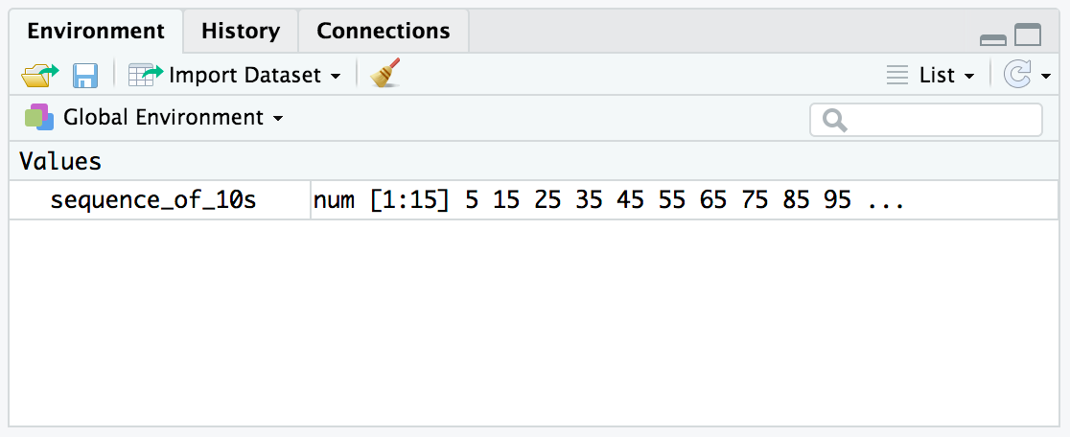
Checking the contents of an object
The environment tab shows us the objects we have created.
Notes:
We can also review our object in RStudio via the environment tab.
When we create an object in the environment, it will appear in the environment tab and we can review its contents there.

Slide 27

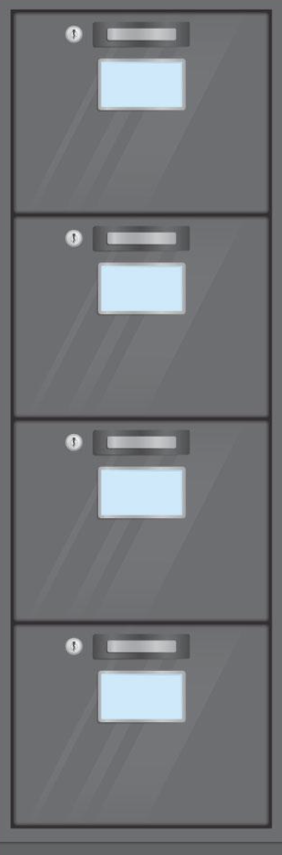

Files on desktop/remote server
CPU when executing code
RStudio Environment
Workspace
Numbered letter boxes
Files
/
Procedures
Data
/ / / / / / / / / / / / / / / / / / / / / /
/ / / / / / / / / / / / / / / / / / / / /
/ / / / / / / / / / / / / / / / / / / / / / / / / / /
/ / / /
/ / / / / / / / / / / /
CPU Cache
RAM
Hard drive
Notes:
This little animation sequence uses letter boxes to illustrate some things about how computers operate. The file cabinets are the non-volatile storage (discs, etc.), the letter boxes are volatile storage (RAM) and are cleaned out every night. The desk is the CPU with its vertical file representing CPU cache (which is also cleaned out every night). The initial file in location 1 is a set of instructions for which file to load first each morning (the BIOS). That first file has instructions for the day, which involve loading a file from the file cabinet, with each page going sequentially into neighboring letter boxes. The worker keeps track of which file is where in the letter boxes and how far along in it they are. Based on the first file, the worker loads a second file and proceeds to work with its pages. As the worker progresses down the pages, they are moved to the vertical file on the desk for convenience and speed. Sometimes the worker creates new pages and loads them into the letter boxes. At the end of the day, the new pages that will be saved are loaded from the letter boxes in the file to preserve them. At the end of the day, the worker leaves and the letter boxes and vertical file are emptied.

Slide 28
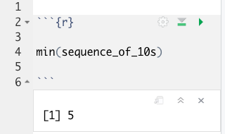
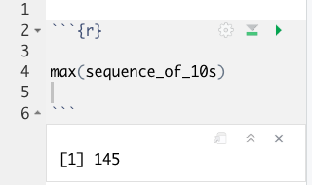
Bending objects to your will
Once we have created an object we can start to interact with it.
This includes passing our objects to other functions… Whoa!
Notes:
Objects are subject to same laws of programming we have learned so far.
We can provides objects as arguments for functions.

Slide 29
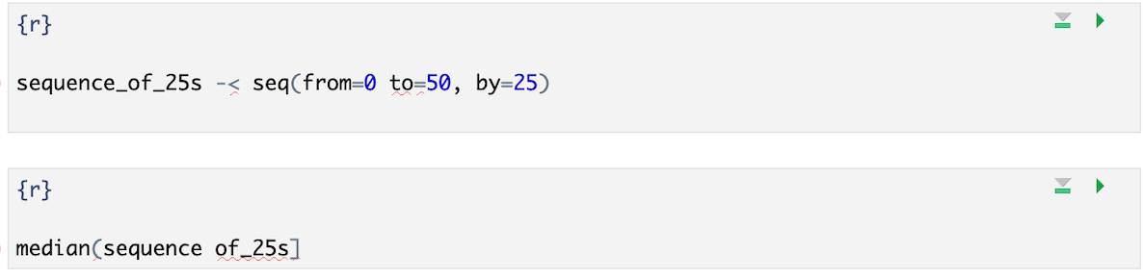
Your Turn
I’ve written some code to create a sequence from 0 to 500 in increments of 25 called sequence_of_25s. Ultimately I want to calculate the median value of this sequence. Unfortunately I’ve made some mistakes in my code and I am hoping you can help me find them.
Notes:
We will meet back together in a minute to see if we can fix this code together.
Hint: There are a total of 5 mistakes.

Slide 30
Common functions: combine values into a vector
object
(stores output)
function
(does stuff)
arguments
(input)
short_vector <- c(1, 2, 3, 4, 5)
Create an object called short_vector and store a vector containing 1 through 5
Think of this vector as a column of numbers you can apply functions/perform calculations on

Slide 31
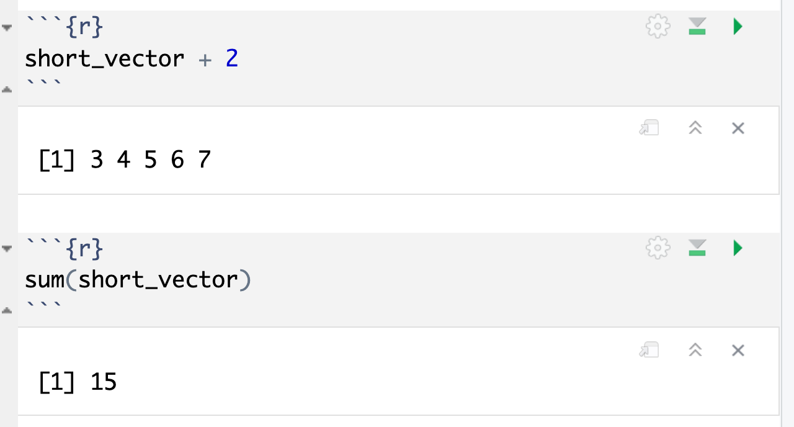
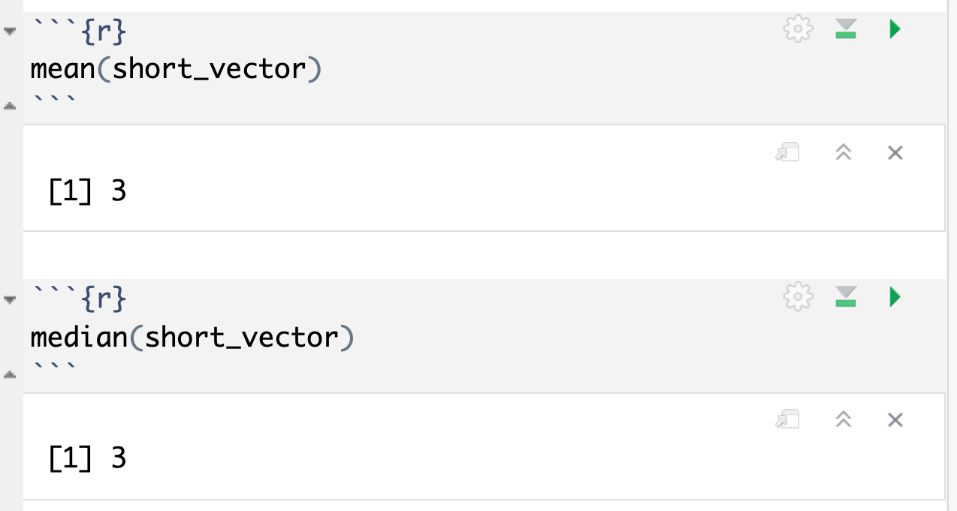
Common functions: simple statistics

Slide 32
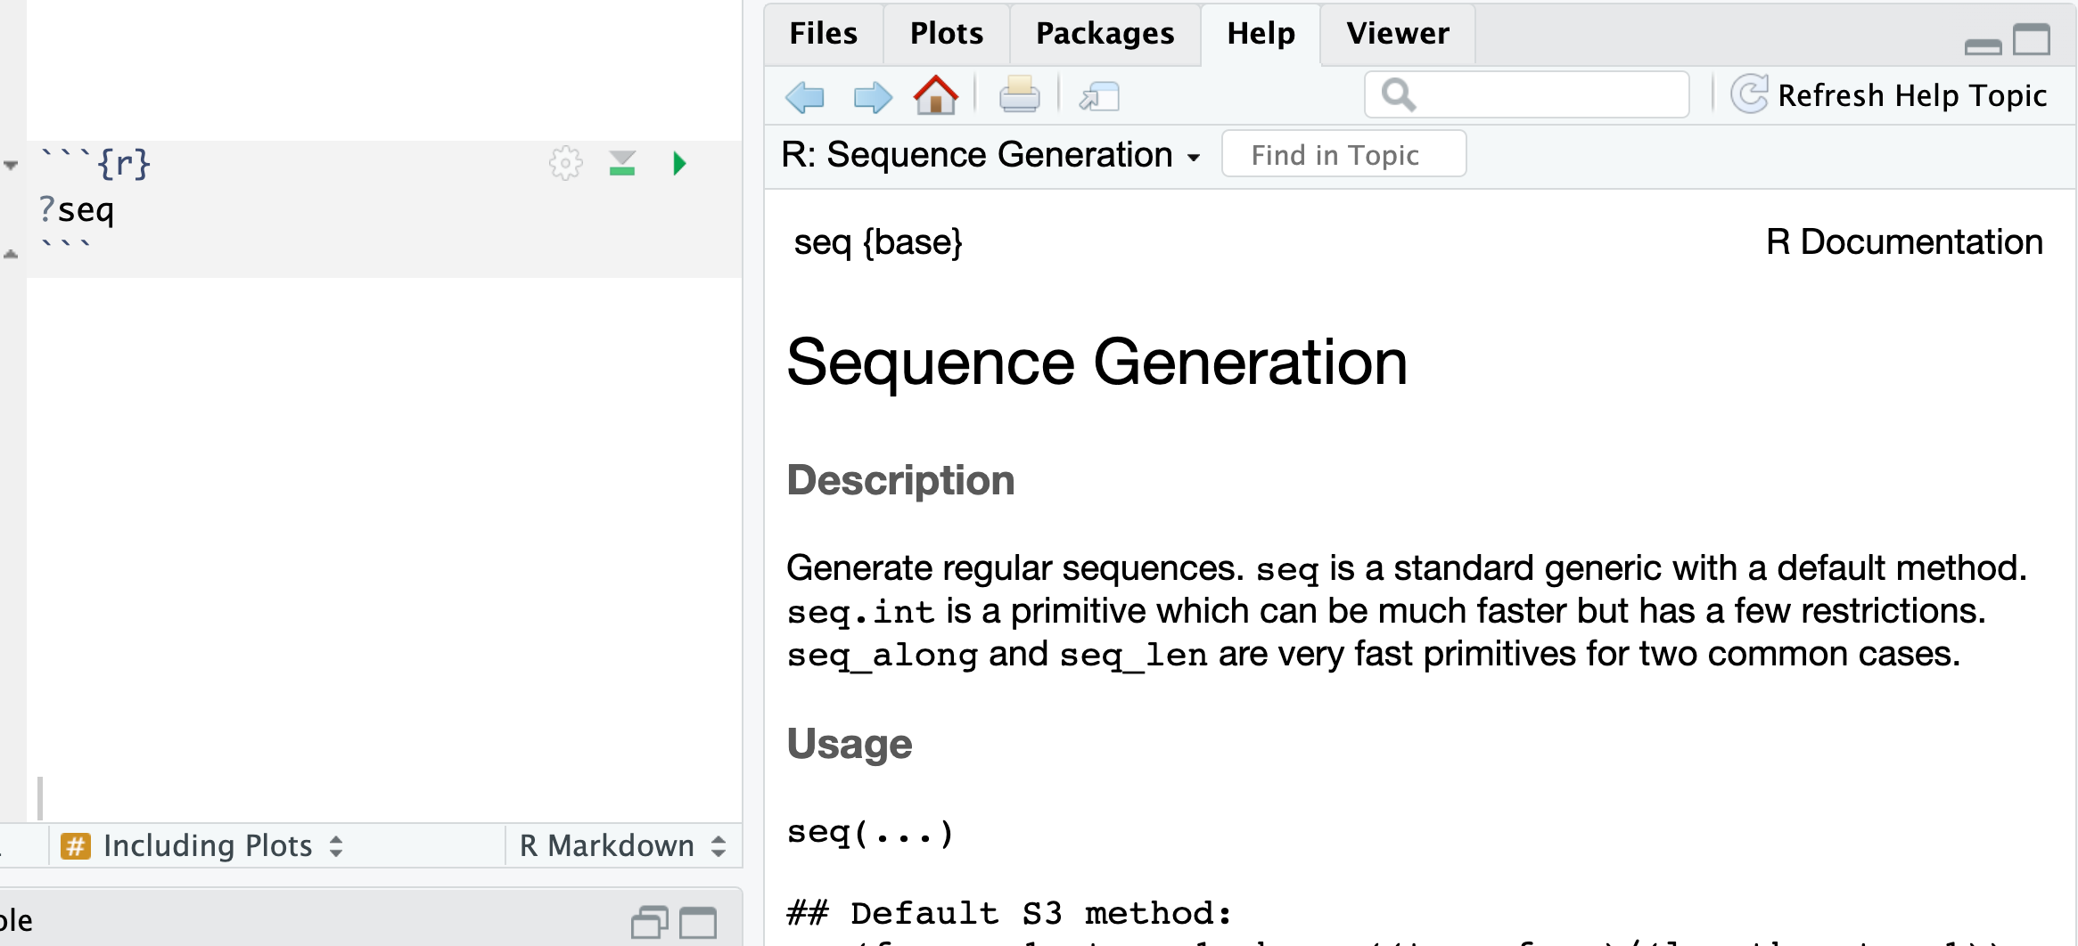
How do I find out more about functions?
Work Aids (RStudio Cheat Sheets: https://www.rstudio.com/resources/cheatsheets/)
A Good Book (R for Data Science: http://r4ds.had.co.nz/)
The Internet (Stack Overflow: https://stackoverflow.com/)
Notes:
Sometimes you will need more help than the R help feature provides.
There are many wonderful freely available resources on the internet to assist you.
Chances are others have tackled similar challenges. A quick internet or forum search can often provide an answer.
The folks at RStudio have developed a number of cheat sheets which are great references. Many of us keep printed copies of these near our desks for the features and tools we use most.
Also, there are a number of great reference books out there. One of our favorites is R for Data Science. It is freely available online and print copies are available also.

Slide 33
Importing Data
Notes:
Now that we are familiar with how to create R Markdown documents we can begin the process of performing data analysis in R in earnest by importing a clinical data set.

Slide 34
The Data Analysis Pipeline
From R for Data Science (https://r4ds.had.co.nz/introduction.html)
Notes:
This diagram may look familiar, you saw it in the Welcome presentation.
The first step in the data analysis pipeline is to load the data into the environment so we can begin to tidy and transform that data.
In today’s course we will be using a de-identified data set consisting of COVID-19 laboratory test results from a microbiology lab. This data is stored as a CSV file.

Slide 35

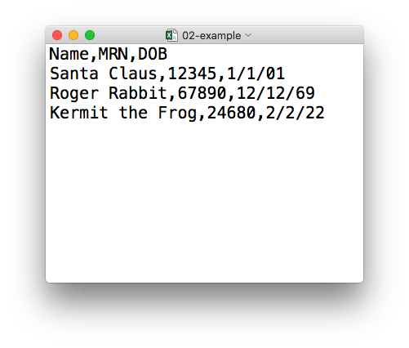
plain text (“flat”) file
csv
rectangular structure
header row
Notes:
So what’s a CSV file? CSV stands for comma-separated values.
** A CSV file is a plain text file, which means you can open it in a text editor and look at it.
Here we have a CSV file with the names, medical record numbers, and dates of birth for three fictional “patients”
** This data structure is called rectangular because it falls into rows and columns, where each row has the same # of columns, and each columns has the same # of rows.
** Also note that this particular CSV file has a header row that instead of data, has a descriptor of what kinds of data are found in each column. CSV files often but not always have such a header row.

Slide 36
Tidyverse: R Packages for Data Science
A consistent way to organize data
Human readable, concise, consistent code
Build pipelines from atomic data analysis steps
Notes:
To import our CSV data, we need some additional data analysis tools. In this course, we will be leveraging the Tidyverse.
The Tidyverse is a modern set of tools for data analysis in R. It’s quickly becoming the de facto standard for doing data science with R.
The basic tenets of “tidy” data analysis include:
Data should be organized in a consistent, standardized way. Each row is an observation, and each column is a variable. This is a very common way to organize data in a spreadsheet and might sound familiar from how you may already organize data in tools like Excel.
Programming code that acts on the data should be consistent, concise, and mimic the narrative language as much as possible.
Each data analysis can be broken down into a series of atomic steps, such as “select this column” or ”arrange the data by the values in that column”. An arbitrarily complex data analysis can be broken down as a pipeline of atomic steps.

Slide 37
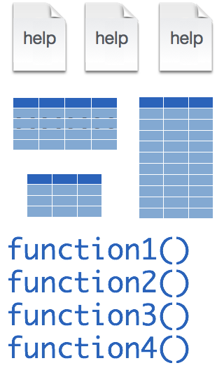
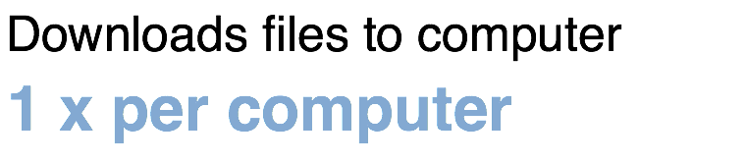
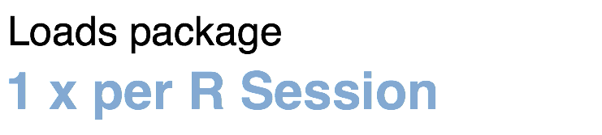
Installing and loading R packages
tidyverse
install.packages("tidyverse")
library(tidyverse)
Note: you will have to reinstall packages when you upgrade to a new version of the R language (not a new version of RStudio, though)
Notes:
The Tidyverse is package (a collection of functions, data, and help documentation) that we can use to extend the functionality of R.
Packages need to be installed explicitly – with the command install.packages. So let’s say you want to install a package named “tidyverse”. You go to the R Console and type install.packages(“tidyverse”).
Each package you want to use needs to be installed only once on each computer. However, in order to use the functions or data in the package, you also need to load the package. This is done with the command “library”. So to enable all the functions in the “tidyverse” package, you type library(“tidyverse”). Packages remain loaded until you quit R. So every time you start a new R session you have to load each package that you want to use again.
On our RStudio Server, you won’t need to install any packages for this course (we have installed them for you). But at times in this course you’ll need to load packages.
So these are the first two R commands we’ve covered - install.packages and library.

Slide 38
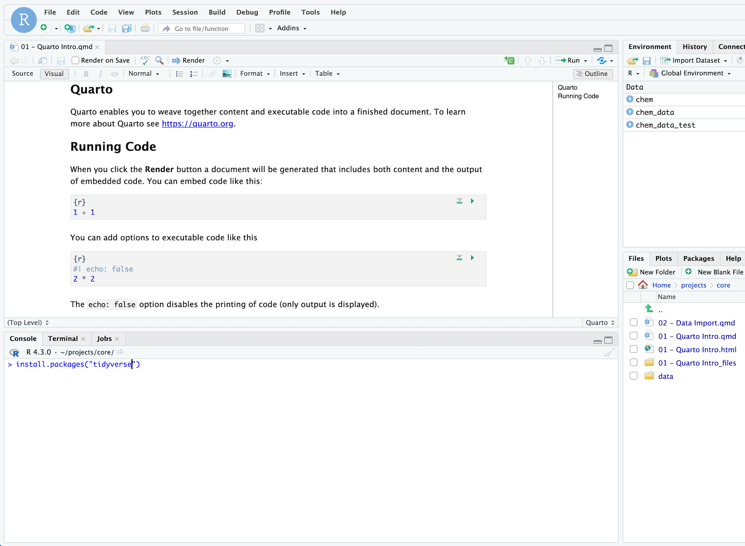
Your Turn
If you followed the precourse instructions you have already installed the tidyverse package.
Install the “skimr” package using the install.packages() function in the Console.

Slide 39


Dataframes: Beyond the Vector
Dataframe is the term for a type of table that aligns with the “tidy data” model
Dataframes are composed of:
  Columns (Variables)
  Rows (Observations)
Dataframes are objects and can be acted on like other objects
csv
xls
db
Notes:
Dataframe is the term we use for a table (think Excel spreadsheet).
Dataframes consists of columns (variables) and rows (observations). This is the tidy way to organize our data.
We can store dataframes as objects and perform actions on them like other objects.
We can get data into R from a variety of file formats (comma separated value files, excel spreadsheets, or directly from databases). This is the import part of data analysis.

Slide 40

read_csv()
data_frame <- read_csv(file_name)
csv
Notes:
Once, the Tidyverse package has been loaded via library, we can import CSV files using the read_csv() function.
Here is a template for how to use the read_csv function to create a data frame object from a CSV file.
You start with the name of a data frame object then you have this left-ward arrow then read_csv and then the file name in parentheses.

Slide 41
function
(does stuff)
data_frame <- read_csv(file_name)
Notes:
This code construct is exceedingly common in R, so I want to spend a few minutes exploring it together
Previously we talked about the absolute value and sequence functions.
read_csv() is also a function. Remember that functions are defined in packages. We loaded the Tidyverse package to be able to use the read_csv function.
You may be familiar with functions from math class. A function takes an input, say an ‘x’ value and returns an output, say a ’y’ value. Functions in computer programming also take inputs and return outputs. But the inputs and outputs here are the arguments and objects that exist within the context of a programming language.
For read_csv, the input is the file name of a CSV file; and the output is a data frame with the contents of the file.

Slide 42
function
(does stuff)
argument
(input)
data_frame <- read_csv(file_name)
Notes:
The input that goes into a function is called an argument. The argument to a function gets put in parentheses.
A function can have zero, one, or many arguments. If there is more than one argument, we use commas to separate them (remember the multiple arguments of the sequence function). We’ll see additional examples of this later.

Slide 43
object
(stores output)
function
(does stuff)
argument
(input)
data_frame <- read_csv(file_name)
Notes:
- The read_csv function outputs a data frame (think table), but if we want to *capture* that data frame inside of a named object, we need to specify that explicitly. It is a great idea to capture the output of a function in an object so it can be used as the input for other functions, for example to summarize or visualize the data in the named object.

Slide 44
object
(stores output)
function
(does stuff)
argument
(input)
data_frame <- read_csv(file_name)
assignment operator
(“gets”)
Notes:
To put the output of the read_csv function into a named object, we use the assignment operator.
The assignment operator is a smaller-than followed by a dash or minus and looks kind of like an arrow pointing left. It’s usually read as “gets.”

Slide 45
read_csv()
data frame to read data into
name of
CSV file
chem <- read_csv("chem_data.csv")
chem
chem_data.csv
csv
Notes:
Let’s put these pieces together to load our covid data set.
This line of code reads the “covid_testing object gets the output of the read_csv function on the covid_testing CSV file”.
You might notice that one of the objects is put in quotes and the other one isn't.
To be honest, quotes can be confusing. Names of objects such as data frames don't get quotes. In contrast, literal file names are always put in quotes. This is part of the grammar of coding (the syntax) in R that will become more familiar to you as you develop proficiency and comfort with the language.

Slide 46
Best Practice: Data Analysis Should be Separated from Raw Data
No matter how you choose to analyze your data you should always create a new file for your analysis
Why?
  Traceability: it is more difficult to identify mistakes in an analysis if you can’t look back at what you originally received
  Mistakes: if you overwrite an important cell or field you may not be able to identify the mistake and may not be able to fix it without re-requesting the data

Slide 47
How do you separate your analysis from raw data?
In Excel: use “Save As…” immediately after you receive your data
In R or other programming languages, reading a file in generally does not change the original file
  This can help enforce good practices
  If you need to create an output file, you can use a write to file function (later this lesson)
Name your output/analysis file with a name that you’ll be able to recognize a year from now

Slide 48
Best Practice: Always Inspect your Raw Data
Before diving into a data analysis, lay eyes on the data set
  Can open the file in Excel
  Programming language development environment may also allow you to look at the raw data – e.g. Rstudio
Understand the meaning of rows and columns: tidy data

Slide 49
Your Turn
Open the Quarto file in the exercises folder:
“Module 02 – Data Import.qmd”
In the Editor pane, follow the instructions in the first 2 sections to complete the exercise. Stop when you see “Stop Here”.
Notes:
One final your turn in this session.
In this exercise, we will ask you to open an R Markdown document and follow the instructions contained in that document to load and explore our data set.
We will meet back in 5 minutes to go over this exercise together.

Slide 50
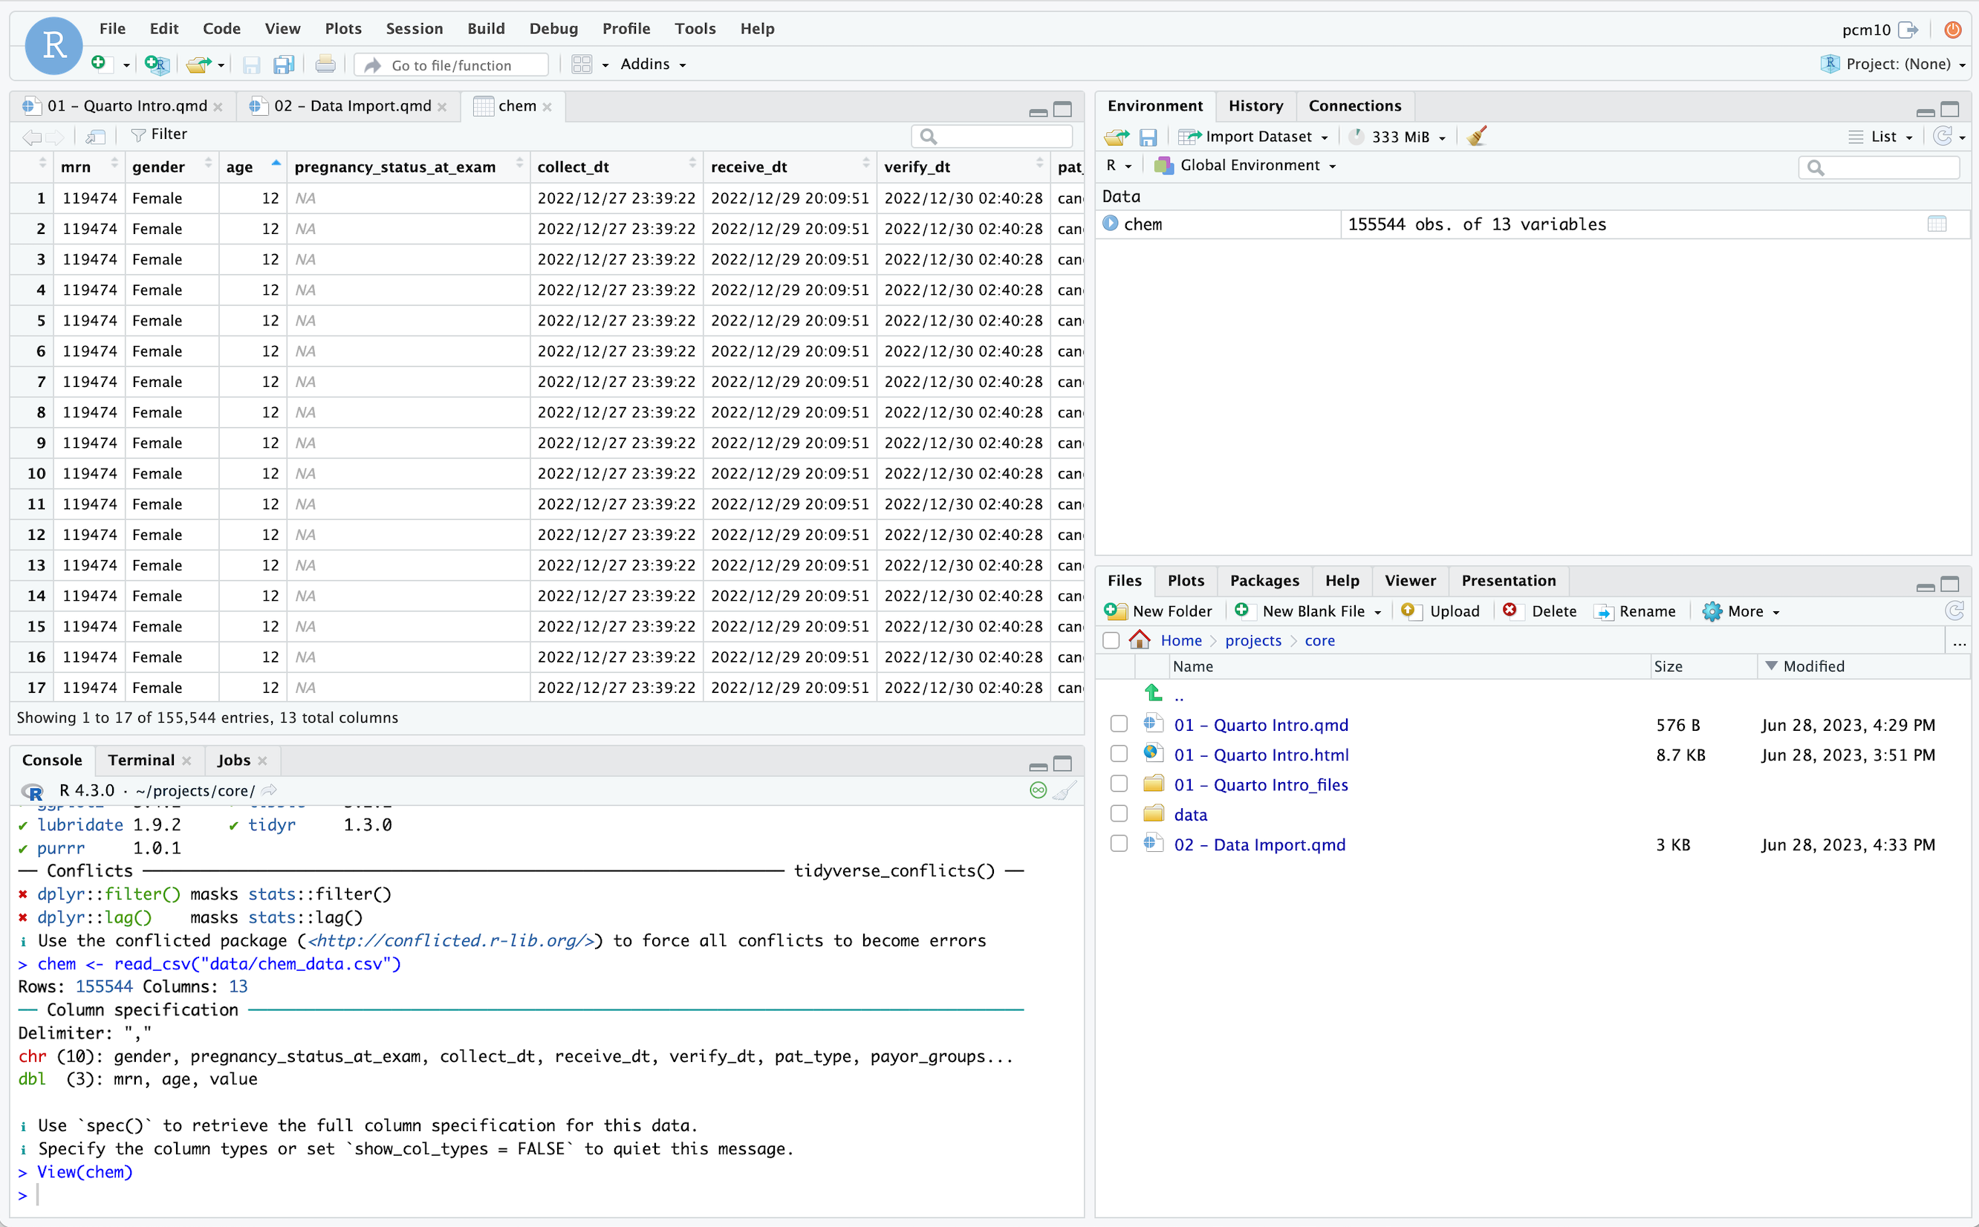
Can sort by clicking on variable
Click on object in Environment
Can open up viewer from console

Slide 51
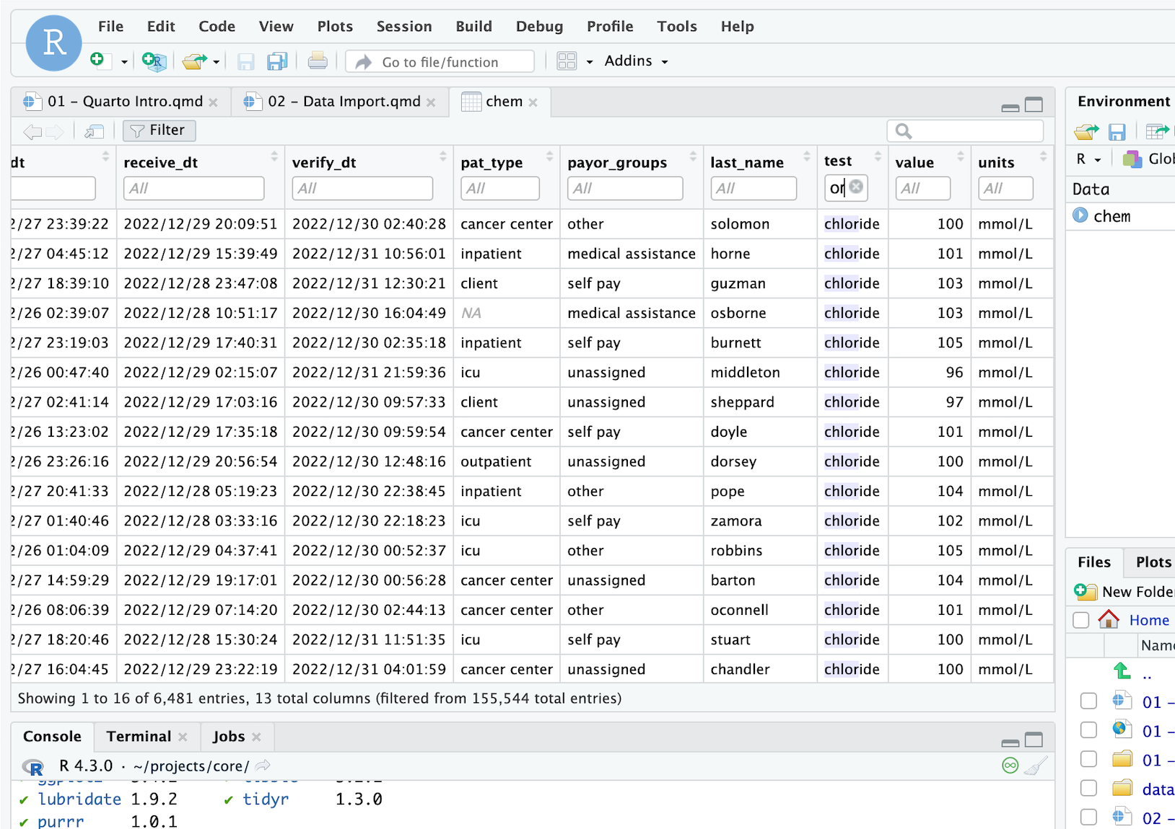
Filter can search variables
Shows rows meeting criteria

Slide 52
Best Practice: Always Inspect your Raw Data
Inspect for any missing data
  How is missing data represented? Blanks, NULLs (SQL), NAs (R), -1?
  Programming languages provide functions that perform a summary of the data set
If applicable, sort data column by column
  Most helpful if each column = specific field or data element
  Helpful to see the “lowest” and “highest” values by column
  Can identify unexpected data types

Slide 53
Your Turn
Pick up where you left off in “Module 02 – Data Import.qmd” and work through the Identifying Data Types section.
In the Editor pane, follow the instructions to complete the exercise. Stop when you see “Stop Here” and put up your sticky to signal that you are done.
Notes:
One final your turn in this session.
In this exercise, we will ask you to open an R Markdown document and follow the instructions contained in that document to load and explore our data set.
We will meet back in 5 minutes to go over this exercise together.

Slide 54
2.1 Why Use a Programmatic Tool?

Slide 55
From Cells to Operations
A spreadsheet asks: what value goes in this cell?
A script asks: what operation transforms this whole dataset?
That shift — from individual cells to systematic operations — is the mental model this entire course is built on
You are no longer editing values. You are describing a process.

Slide 56
Why It Matters: Reproducibility, Auditability, Scale
A spreadsheet remembers your last click. A script remembers your entire reasoning.

Slide 57
What This Looks Like in Practice
 | Spreadsheet | Script
Repeat an analysis next month | Redo every click | Re-run the file
Explain what you did | Try to recall | Read the code
Catch a mistake | Hope someone notices | Re-run and compare
Hand off to a colleague | Walk them through it live | Send the file
None of this requires you to be a "programmer" — it requires you to write down what you did.

Slide 58
Check-in 2A: RStudio Orientation (8 minutes)
Open the course .Rproj file from your file system
In the Console, type 1 + 1 and press Enter — confirm you see [1] 2
Return to module_2_exercises.qmd, run the setup chunk
Fill in the RStudio Panes table and answer three written questions in the exercise file.

Slide 59
2.2 R Basics: Objects, Functions, and Packages

Slide 60
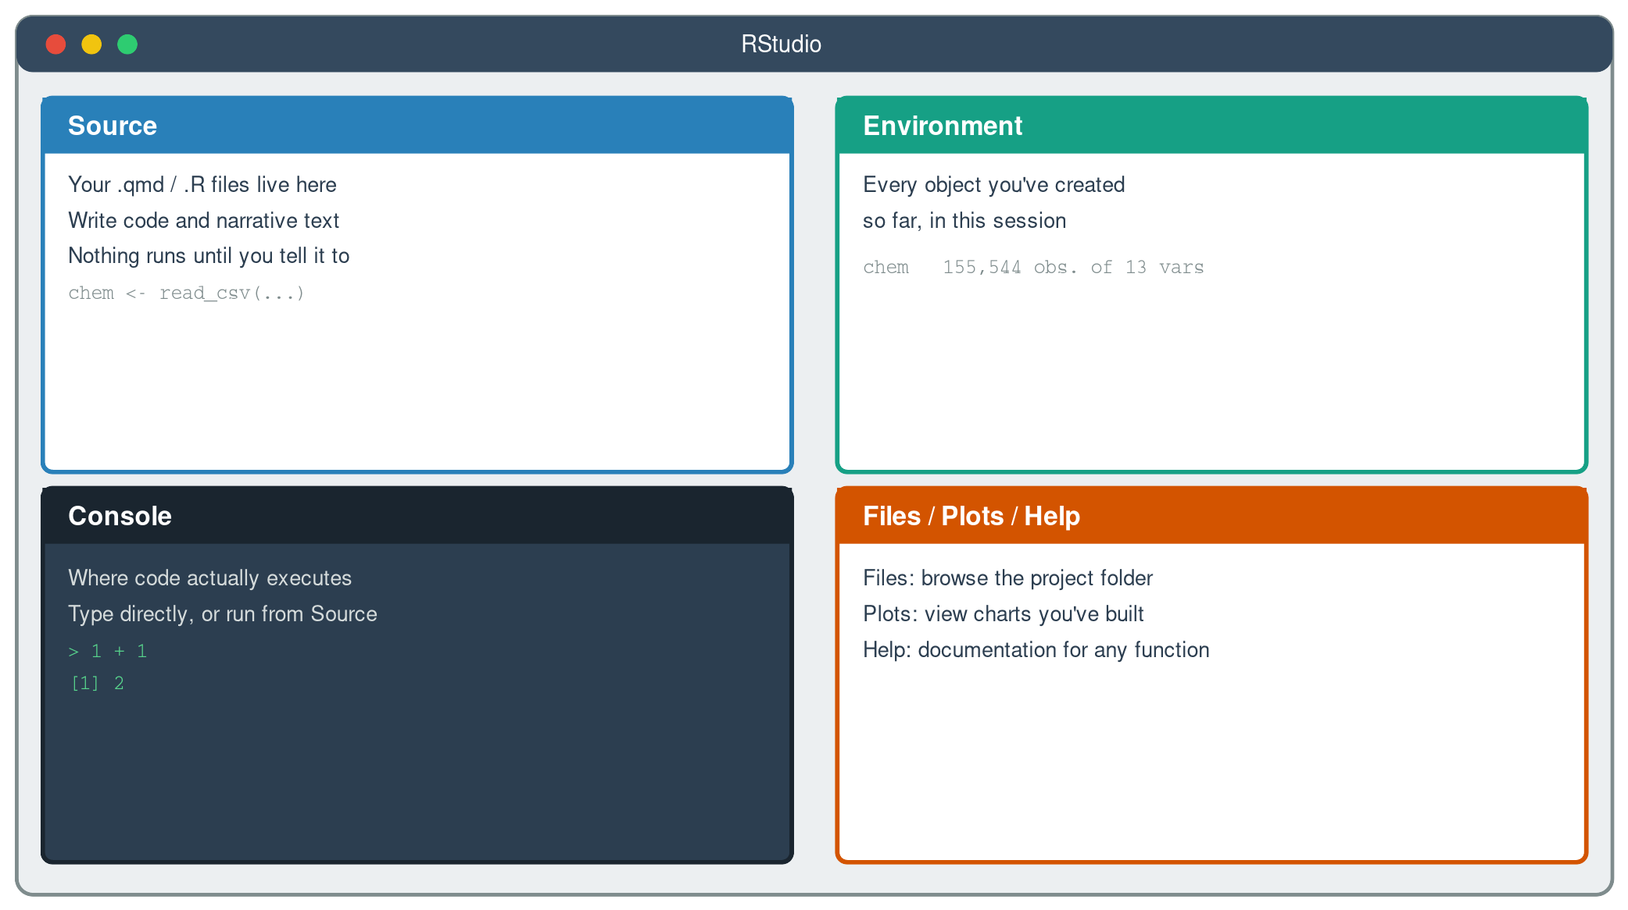
The RStudio Interface, at a Glance
Source writes, Console runs, Environment remembers, Files/Plots/Help supports.

Slide 61
Objects: Naming a Result So You Can Reuse It
<- assigns a value to a name — chem <- read_csv(...) means "call this result chem"
Once assigned, an object shows up in the Environment pane and can be reused in any later chunk
Assignment is how a script remembers — a spreadsheet has no equivalent concept
chem <- read_csv("data/chem_data.csv")
Every object is a named, reusable answer to a question you already asked.

Slide 62
Functions: Verbs That Act on Objects
If you can name what you want to happen to your data, there is very likely already a function for it.

Slide 63
Packages: Bundled, Reusable Tools
A package is a collection of functions written and shared by someone else, so you don't reinvent them
library(tidyverse) loads the one package family this entire course relies on
Packages must be installed once, but loaded (via library()) every new session
Almost every function you'll type this week comes from a package someone already built and tested.

Slide 64
RStudio Needs a “Point of Reference”
Every time R reads or writes a file, it looks relative to one location: the working directory
Write "data/chem_data.csv" and R has to guess which data/ folder you mean — it guesses based on the working directory, not where the file "obviously" is
No defined point of reference means the same code can run on your laptop and fail on a colleague's — or fail on your own machine next month
This is exactly why you opened the .Rproj file first in Check-in 2A, before touching any code
A script that only runs from your Desktop isn't reproducible. It's just accidentally correct on your computer, today.

Slide 65
RStudio Projects Fix the Problem
An .Rproj file marks a folder as a project — opening it tells RStudio "set the working directory here, every time"
Every relative path in your code (data/chem_data.csv) is now anchored to that project folder, regardless of whose computer it lives on
This is why every exercise in this course starts with "open the .Rproj file" — not the script, not the .qmd — the project file first
Combined with a consistent folder structure, this is what makes an analysis portable: it runs the same way on any machine
The folder structure on the next slide only pays off once a project file anchors it.

Slide 66
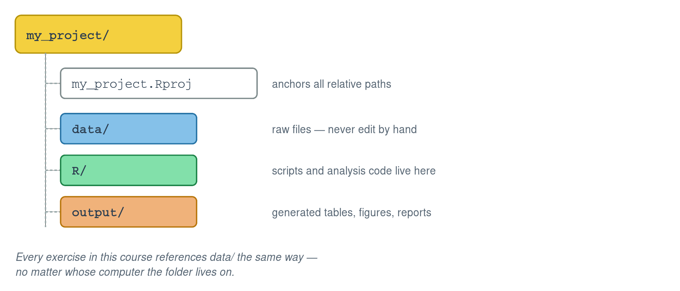
A Simple, Durable Folder Structure
data/ is read-only, in spirit — never overwrite or edit a raw file by hand
The .Rproj file anchors all relative paths so your code works regardless of where the folder lives on disk

Slide 67
2.3 Importing Data with Explicit Column Types

Slide 68
read_csv() and the Type-Guessing Problem
read_csv() reads the first ~1,000 rows and guesses each column's type from what it sees
That guess is often reasonable — and sometimes exactly wrong, especially for dates and categories
A column of "2022/12/26 00:24:02" values has no built-in marker that says "I am a datetime"
A wrong guess doesn't throw an error. It just quietly limits what you can do next.

Slide 69
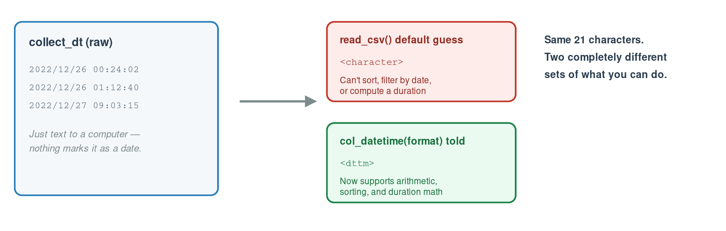
Same Text, Two Very Different Outcomes
Same 21 characters. Two completely different sets of what you can do.

Slide 70
Telling R What You Already Know
col_types = cols(...) lets you specify the type for every column explicitly, rather than trusting the guess
col_datetime("%Y/%m/%d %H:%M:%S") — you supply the exact format the raw text is in
col_factor() — for a column with a fixed, known set of category labels (like pat_type or gender)
collect_dt = col_datetime("%Y/%m/%d %H:%M:%S")
pat_type = col_factor()
You are not fighting R's guess — you're replacing a guess with a fact you already know.

Slide 71
Check-in 2B: Import and Inspect chem_data (20 minutes)
Part 1: Import with default types. Run glimpse() and summary() — identify which columns look wrong.
Part 2: Re-import with explicit col_types. Fill in two blanks: the datetime format string, and the col_ function for pat_type. Confirm the corrections.

Slide 72
2.4 Data Validation Checklist

Slide 73
Why Validation Comes First — Every Time
An import that runs without an error message has told you nothing about whether the data is right.

Slide 74
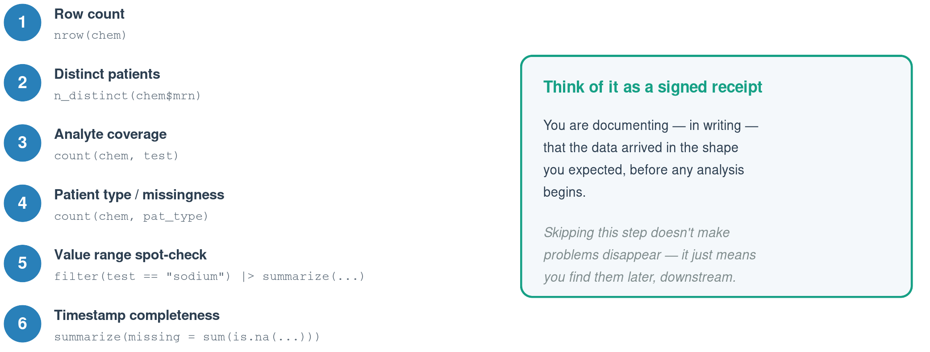
The Six-Step Checklist

Slide 75
What a Failed Check Actually Tells You
Row count off? You may have imported a stale file, or a filter ran earlier than intended
Analyte counts uneven? Some analytes may only be ordered for certain patient types — is that expected?
Missing timestamps? Is that a data entry gap, or a real workflow state (e.g., not yet verified)?
Every checklist item ends in the same question: is this what I expected, and if not, why not?

Slide 76
Check-in 2C: Run the Checklist (15 minutes)
Step through all six validation checks on the correctly imported chem_data. Record your interpretation of each result — not just the number, but what it means.
Closing question: identify one data quality issue you'd want to investigate further before presenting results to a lab director.

Slide 77
Bringing It Together
Interface — Source writes, Console runs, Environment remembers
Organization — The .Rproj file anchors every relative path
Import — Tell R the types — don't trust the guess
Validation — A receipt that the data is what you expect
Mindset — Reproducible, auditable, and built to scale
You now have a validated, correctly typed dataset. Module 3 puts it on screen.

Slide 78
Coming Up: Module 3
Visualization principles and best practices
Choosing the right chart for the question you're asking
Building and refining plots with ggplot2
A first look at code you won't fully understand yet — and that's intentional
Bring the validated chem_data import from today — Module 3 builds directly on it.

